Slide 1
Death Trap
A non-linear narrative
Created by Ian Barrow, Eivinas Zdanevicius & Aleksandr Ovcinikov

Slide 2
Non-linear narrative
Open world narrative – The player is able to encounter the story in whatever order they choose.
Branching narrative – gives the player options that often lead to more options which may affect the overall direction of the narrative
Our narrative:
Open for the player to discover in whatever order they choose
Branching storylines from a singular point to different end points

Slide 3
Summary
Play as Death who has come to reap the soul of an old woman
Explore her past through journal entries
Journal entries come with riddles
Find the old woman’s hiding place
Figure out which journal entries are fake
Get trapped

Slide 4
Journal
Move in day, received a knock at the door from a woman.
Discovers the woman is a runaway, help’s her and lives with her
Wakes up in the night tied up, tortured, and framed.
Discovers the woman is a resistance member, tortures then deceives her for information. Reports her to the authorities.
Learns about the woman’s family. Pays police to kidnap them. Tortures and murders them.

Slide 5

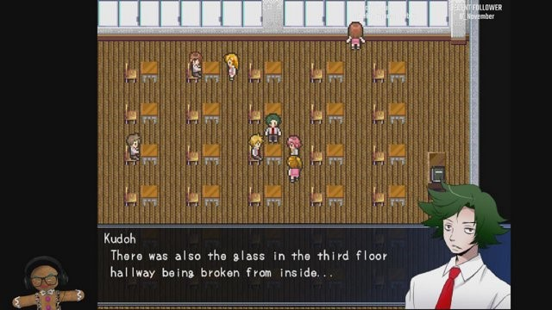
Inspiration
RPGMaker Misao
Pokemon
Dialogue mechanics
Movement mechanics

Slide 6
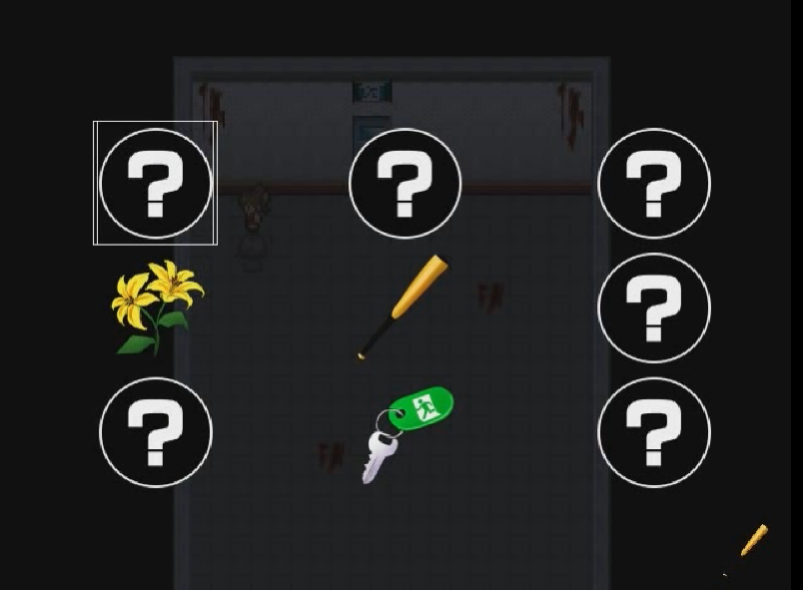
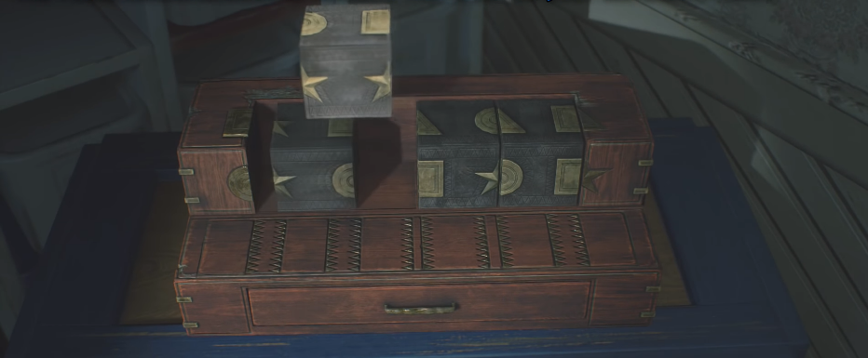
Inspiration Cont.
Resident Evil 2
Misao Inventory
Puzzle mechanics
Inventory mechanics

Slide 7
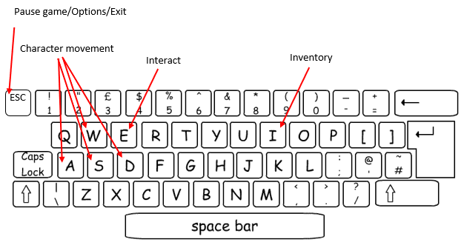
Input

Slide 8
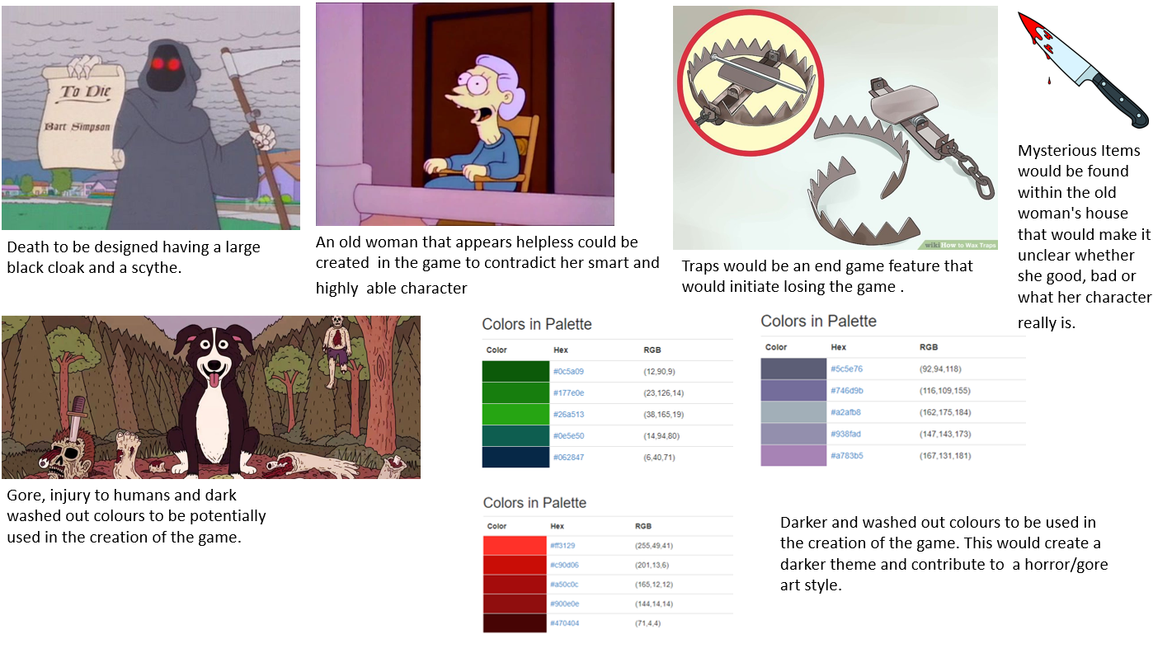
Mood board

Slide 9
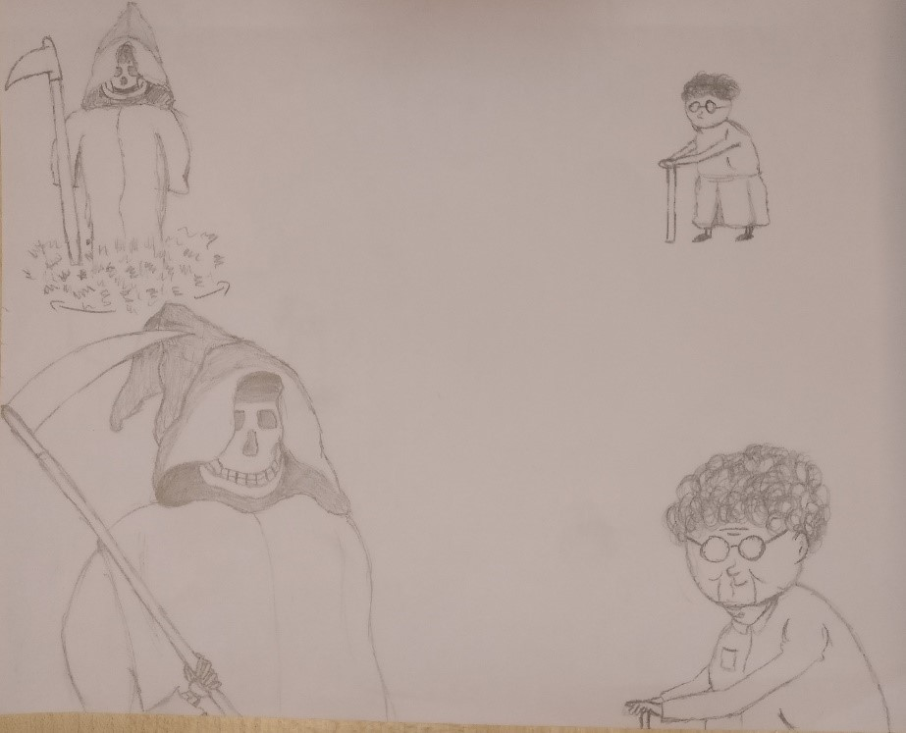
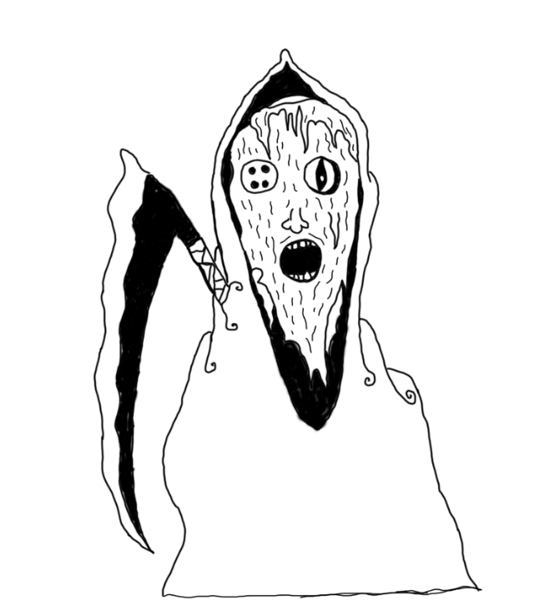
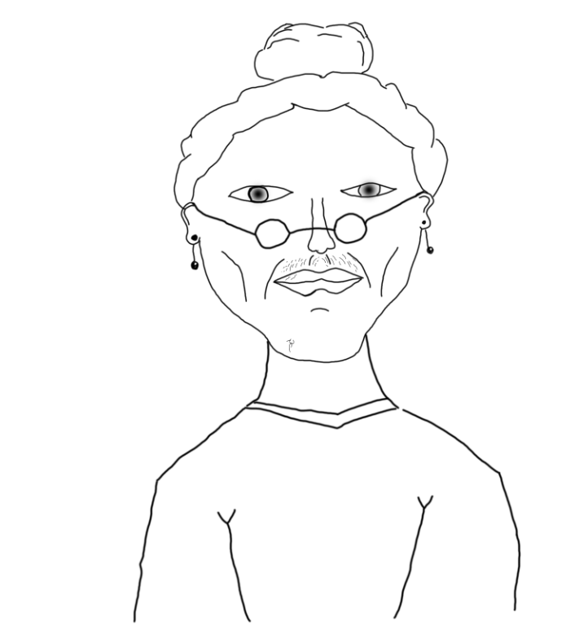
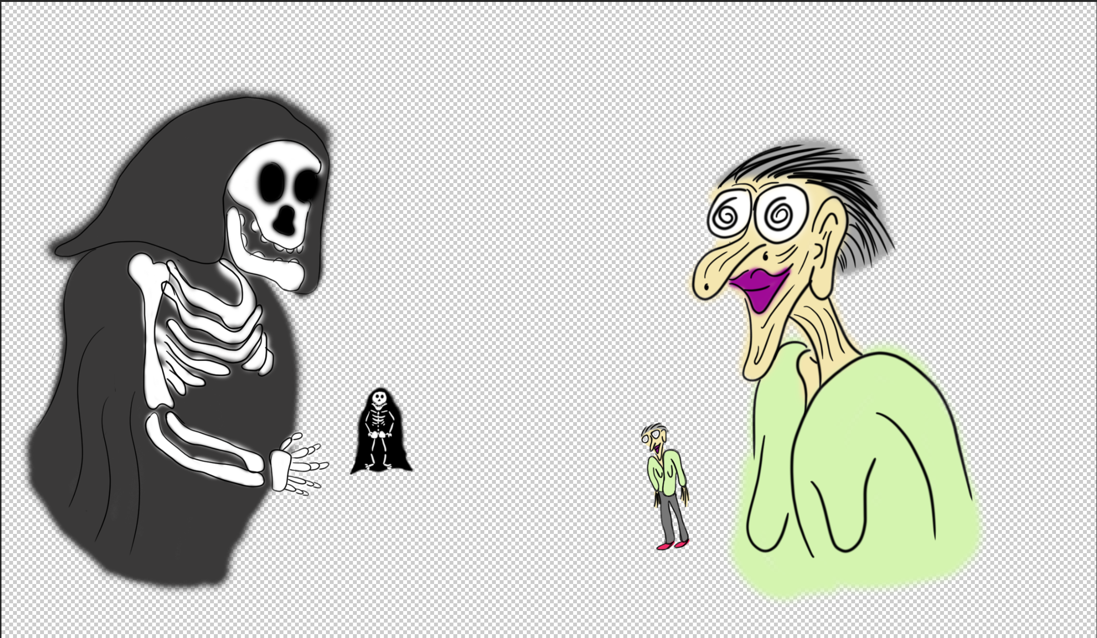
Pre-visualisation

Slide 10
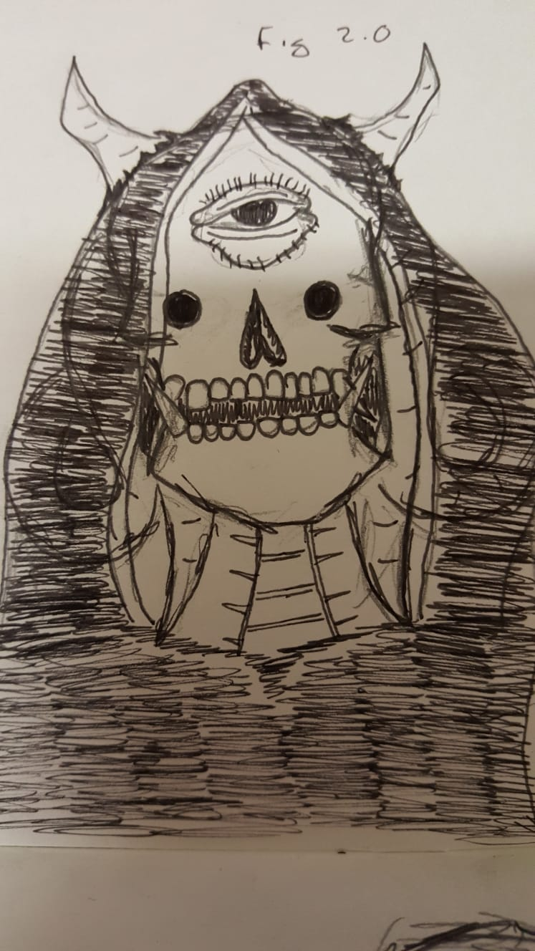
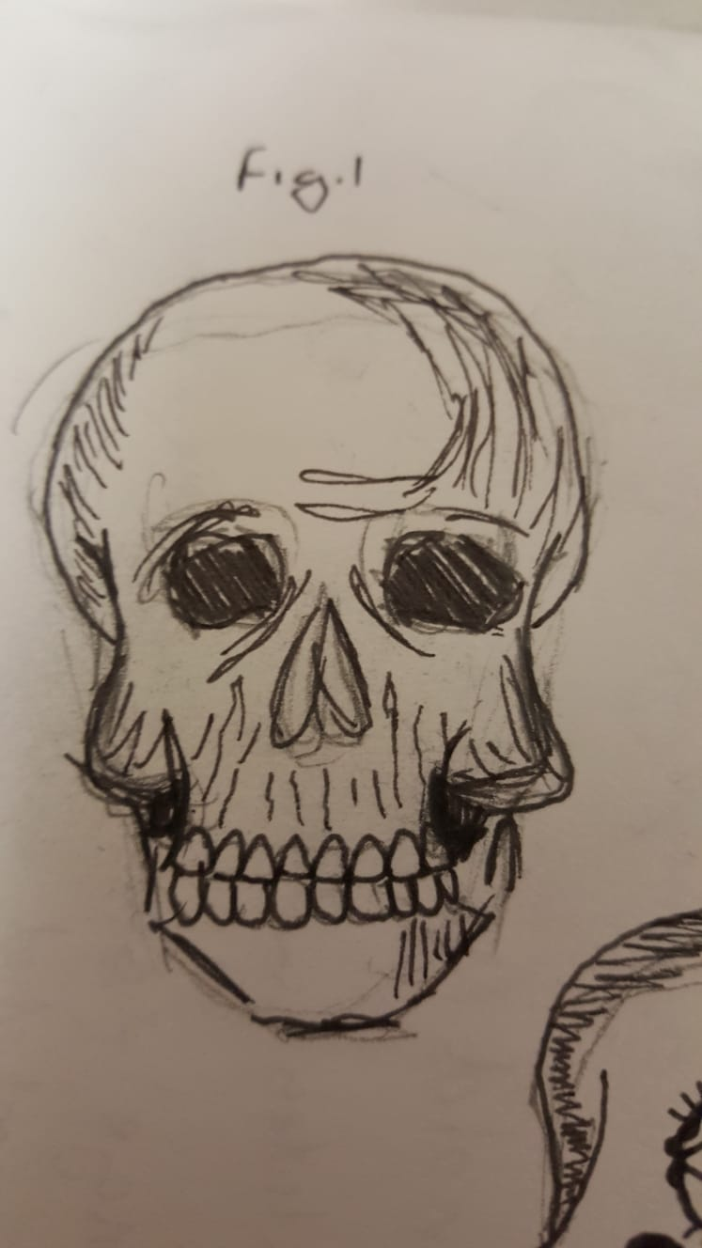
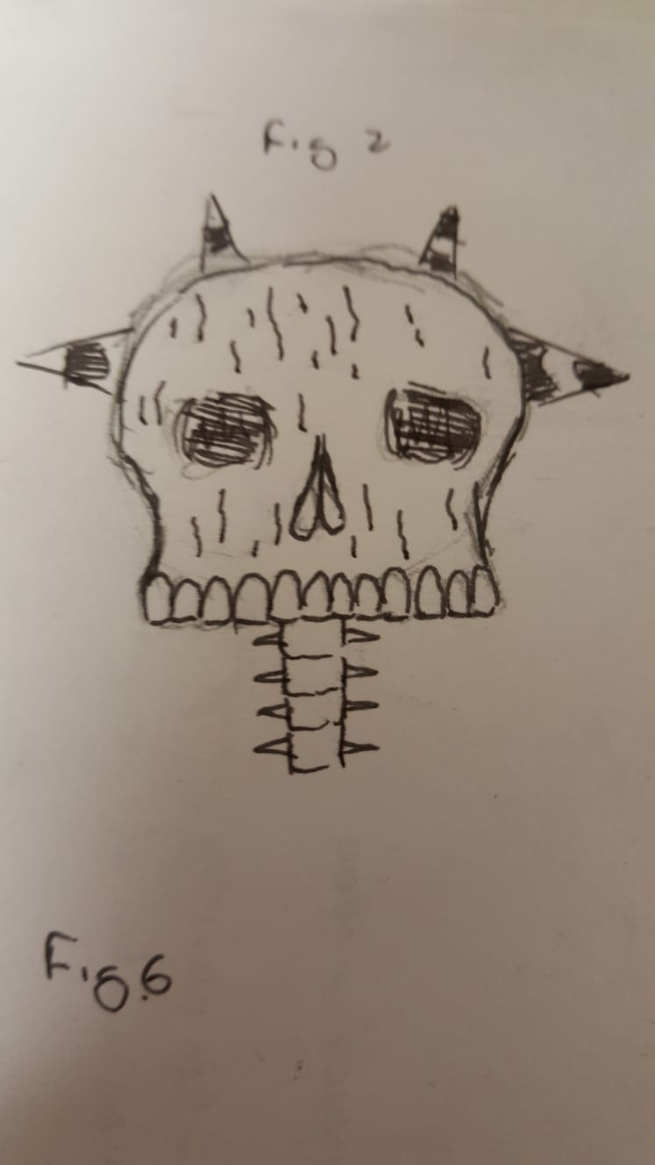
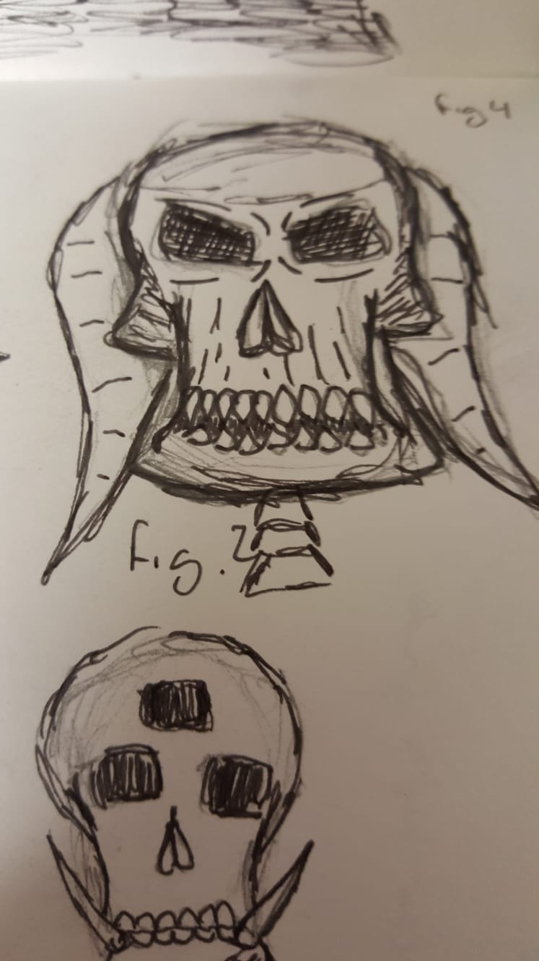
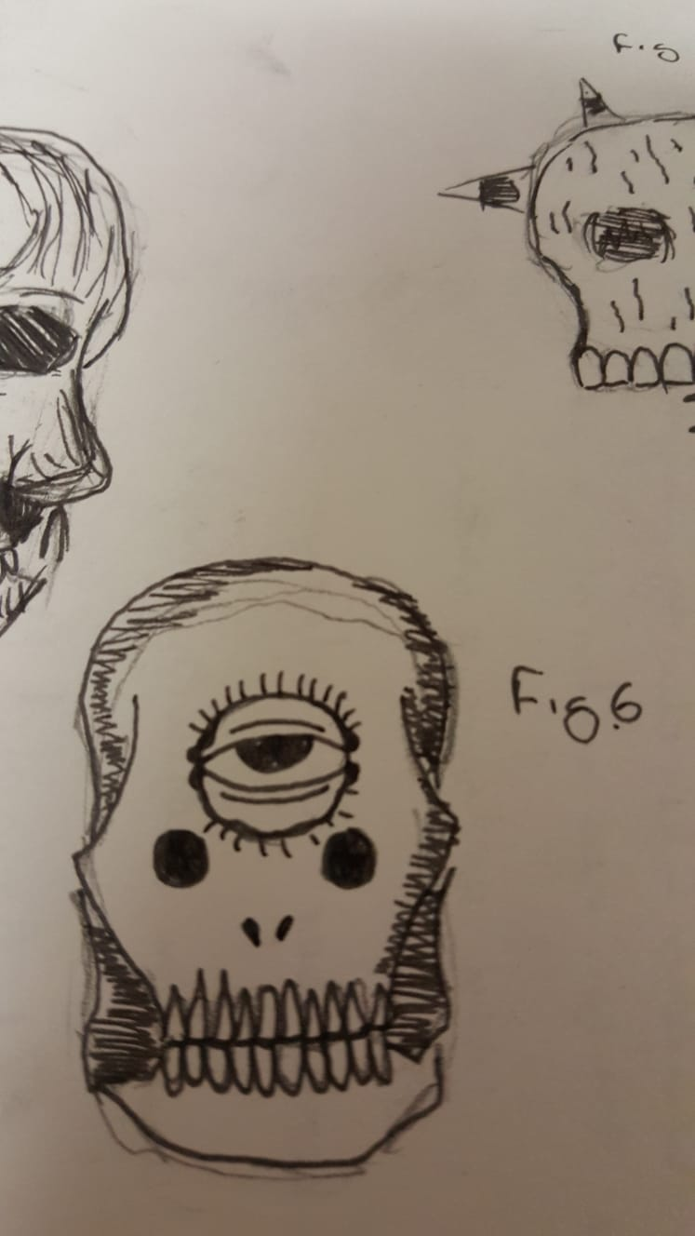
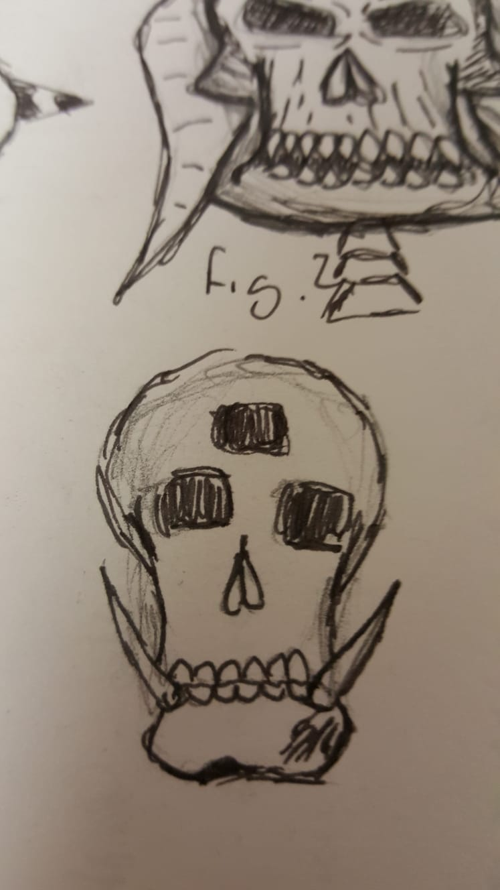
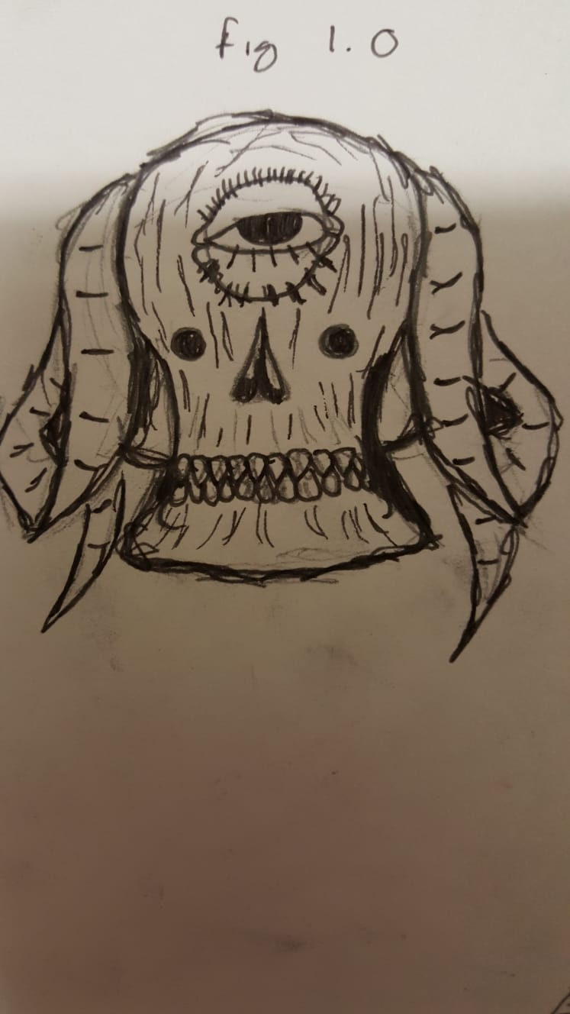
Pre-visualisation cont.

Slide 11
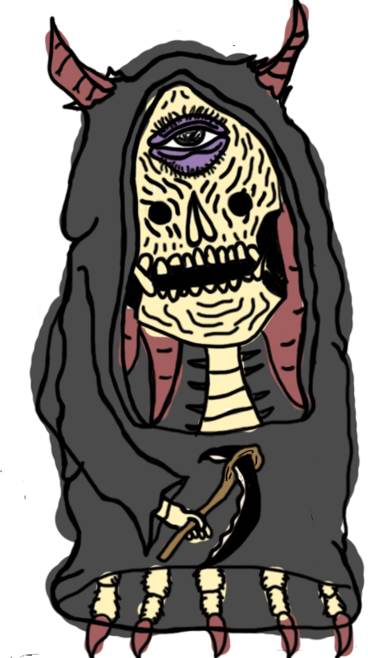
Pre-visualisation cont

Slide 12
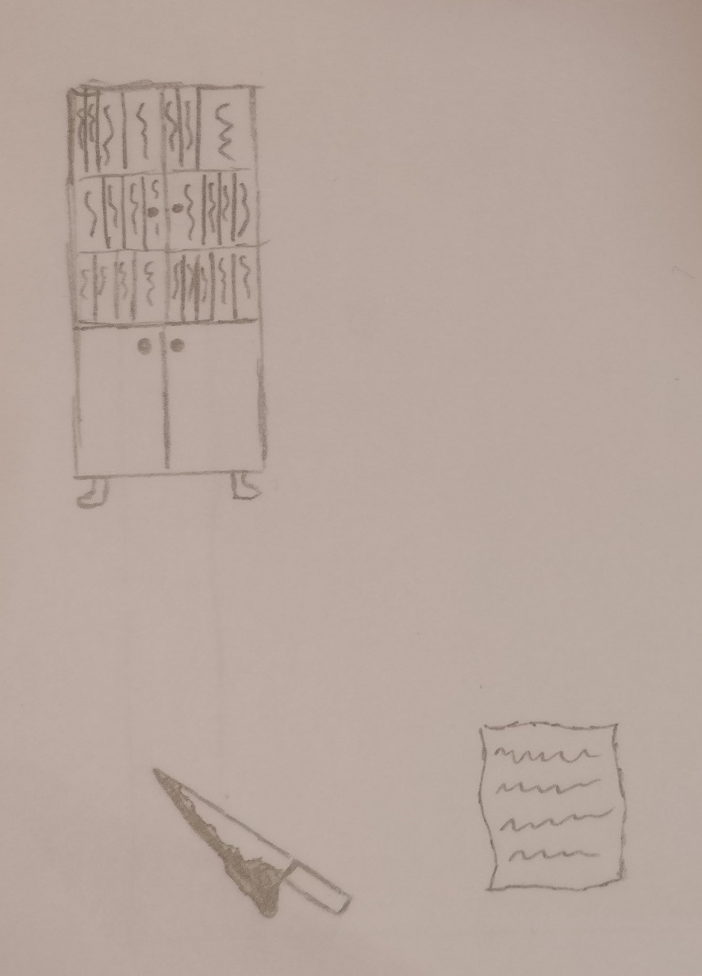
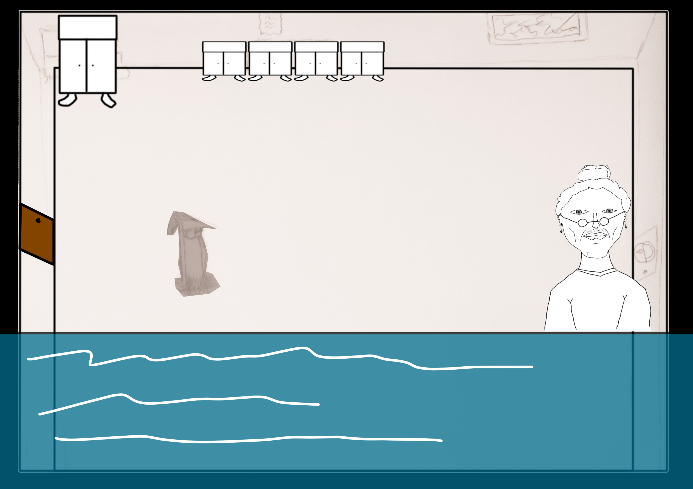
Pre-visualisation cont.

Slide 13
Map
ATTIC
1ST FLOOR
GROUND FLOOR
BASEMENT
HIDDEN BUNKER

Slide 14
aTTIC

Slide 15
1ST FLOOR
HIDDEN ROOM
SPARE ROOM
MASTER BEDROOM
SPARE ROOM
BATHROOM

Slide 16
GROUND FLOOR
LIVING ROOM
HIDDEN ROOM
HIDDEN ROOM
DINING ROOM
KITCHEN

Slide 17
Basement & bunker
BASEMENT
BUNKER

Slide 18
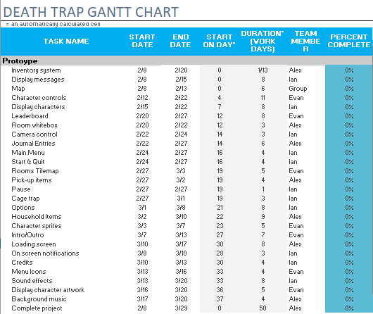
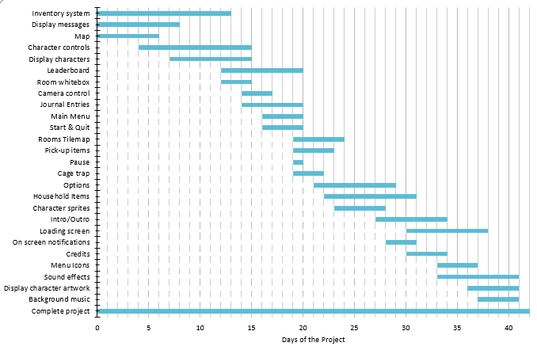
Core mechanics & implementation

